Slide 1
Smart Application Based Blockchain Consensus Protocols: A Systematic Mapping Study
M.Shaheer Uddin
Laiba Hanif Ramsha Yaqoob

Slide 2
Introduction
Traditional methods were used for transactional data:
Bookkeeping
Barter System
Hash cash etc.
First consensus protocol was introduced because of bitcoin which was also later used for measuring reputation of websites

Slide 3
Client puzzle introduced
application of POW
Resolve cryptographic puzzle
POW
based on hash puzzle
Requires computational and electricity
Very secure till date, hasn’t been any proof of threat

Slide 4
Consensus algorithm is constantly adapting and improving
Now there is proof of stake,
delegated POS,
Practical byzantine fault tolerance,
POB,
POA,
POL, and
SCP
Non are perfect!

Slide 5
Consensus algorithm is constantly adapting and improving
Now there is proof of stake, delegated POS,
Practical byzantine fault tolerance, POB,POA,POL, and SCP
Non are perfect

Slide 6
Issues faced by companies
1. 51% mass attack
2. Fork problem
Block maturity standard - invader need more then just 51% computational power

Slide 7
Scope of paper - enhance usability of all condensed protocols
Comparative analysis - to compare between consensus protocols
Basic purpose - describe and differentiate between different consensus protocols

Slide 8
Articles were examined and eliminated based on errors, abstract, duplications.
Primary search was conducted then divided into 4 stages, reducing the number of papers at each stage.

Slide 9
Search scheme was conducted:-
Stage 1- collection of papers
Stage 2- title based search
Stage 3- duplicate removal
Stage 4- abstract based selection
Stage 5 full text based search
Stage 6- finalised articles for analysis

Slide 10
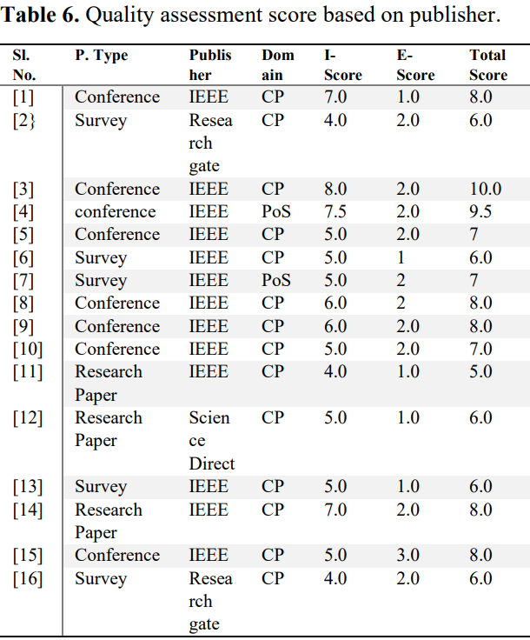
Quality valuation score
Exterior criteria - E-score
Interior criteria - I-score
Publication type - P.type

Slide 11
Abstract
•Blockchain is a potential platform with efficient and robust infrastructure.
•Consensus protocol is a Centre of the blockchain.
•In easy terms, Consensus Protocol is the guarantee for the stable operation of blockchain systems.
•Many experts came across either decentralization or security concerns.
•However ,there are some scientists who made their own protocol instead of using the traditional protocols.

Slide 12
•In this paper, the two main core descriptions are:
1.Some previous and current protocols are discussed with their types, variants, strengths and weaknesses.
2.Comparative analysis with systematic review of most used protocols.

Slide 13
Related Work
•Consensus Protocol with their viability and effectiveness are preferred.
•PoW, was the first consensus protocol, according to Bitcoin and lite coin.
•Proof of eXercise and Proofs of Useful Work does involve technical implications based on orthogonal path but no practical implementations.
•41 Consensus Protocols
•PoW, PoS, DpoS, DDpoS, PoI, Raft, Ripple and Algo Rand are variants of Consensus Protocol.
•DDPOS : Downgrade delegated POS, an efficient consensus algorithm, with following features:
Decreased resource usage
Greater operational performance
Improved protection
● A successful solution for suspicious participant performance

Slide 14
Related Work
•PoW and PoS do not provide multi nodes for functioning in blockchain.
•A proposition was made to use multi tokens protocol that allows mining more than one token, but it gave rise to security concerns.
•According to surveys, PoW is not the best approach due to its consumption of much computational power in comparison to PoS, including easy usage.
•All the comparative analysis is done without comparison table in this paper.
•Assessment of protocols are done efficiently though.

Slide 15
Research Methodology
•Here, firstly the gathering of data from various sources is done
•For the review, different search strategies are used.
•Systematic mapping process
•This map shows how the methodology is formulated and what processes are involved.

Slide 16
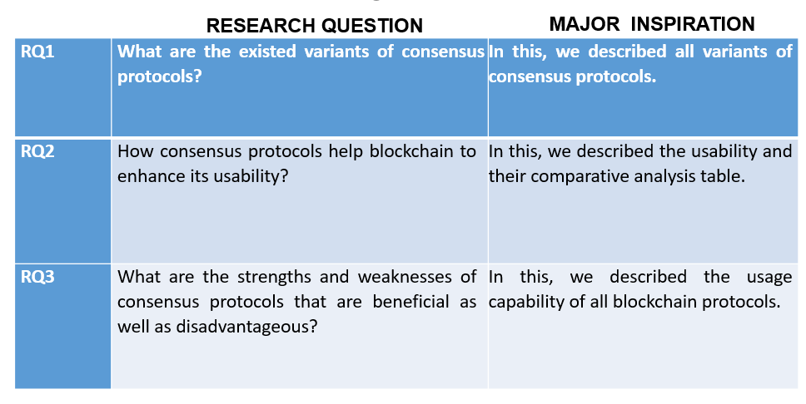
Research Objectives

Slide 17
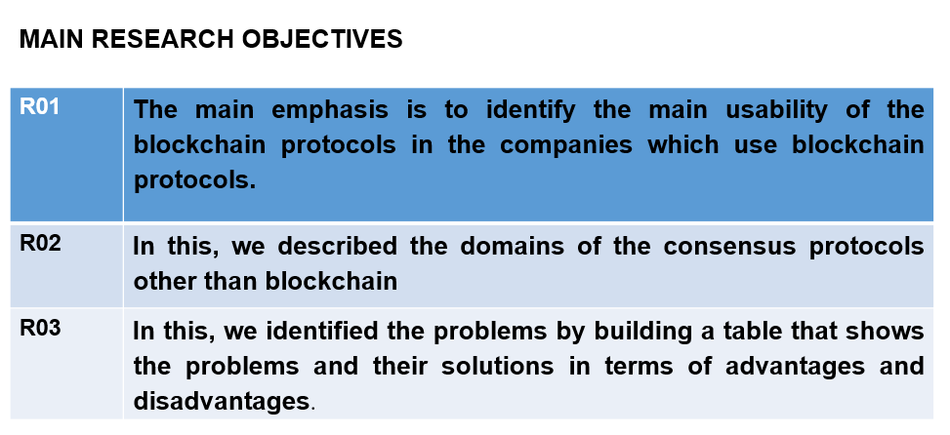

Slide 18
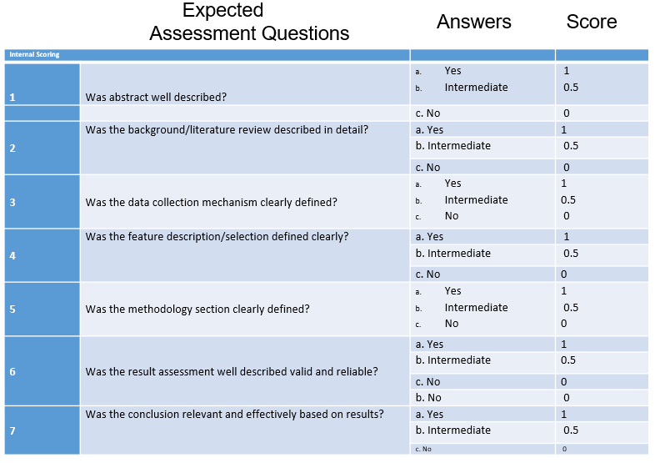
Inclusion and Exclusion Criteria

Slide 19
Consensus Protocols
From the best remaining 16 research papers.
Proof of Work
Proof of Stake
Delegated Proof Of Stake
Proof of Elapsed Time
Zero Knowledge Proof
Proof of Luck
Proof of Activity
Proof of Space
Proof of Vote
Proof of Burn
Proof of Importance
Proof of Trust

Slide 20
Paper in a Nutshell…
Analysis of different Consensus Protocols.
Is PoW the best consensus protocol?

Slide 21
2 Reasons
There are other consensus mechanism…
Enhancement of PoW…

Slide 22
PoET
Based on TEEs (SGX Intel)
Hyper Ledger (Sawtooth) uses it
Randomly selects miners - so energy efficient

Slide 23
PoL
Depends on Private blockchain
Based on TEEs(SGX Intel)
Low tx delay by consuming limited energy
Randomization refer to as luck
Hardware based.

Slide 24
PoA
PoW + PoS
Multi-layered
Authentication and Validation

Slide 25
Others
Proof of Space:
Disk storage instead of high computational power.
Proof Of Importance:
Updated form of PoS.

Slide 26
Proof of Vote
Well organized version of PoW.
Offer controllable security for each node.
Less verification delay.
More reliability.

Slide 27
Proof of Burn
We can combine protocols together.
Example:
Proof of Burn works along with PoW and PoS.
Burning coins are used as evidence instead of nonce computation(PoW)
“Solves some problems of PoW”

Slide 28
PoW’s supermacy
Addressing the common misconception.
Is PoW the best protocol?

Slide 29
Proof of Work
Based on solving a mathematical puzzle.
Nodes Compete.
Nonce is to be found using brute force strategy.

Slide 30
PoS and DPoS
Introduced to solve the problems of PoW
Based on staking.
Mined Forged
Lock certain amount of coins - as stake
DPoS is more democratic in a way that validators are elected.
More decentralization since nodes can easily remove them.

Slide 31
Pros of PoW
Offers high level of security backed by cryptography.
Most used protocol - battle hardened
Provides decentralized method of verifying transactions.
Ultimate Openness.

Slide 32
Still think PoW is the Best?
someone disagrees…

Slide 33
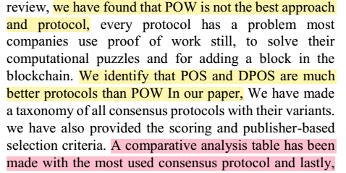
Verdict of Authors
PoS and DPoS > PoW

Slide 34
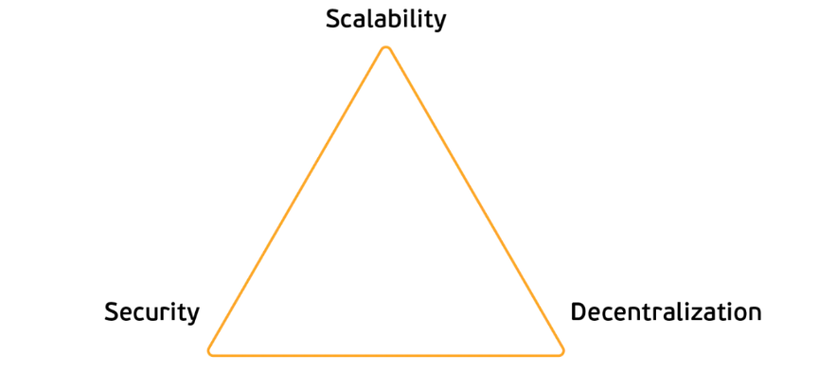
Blockchain Trilemma

Slide 35
PoS vs PoW
Energy consumption.
-Coins losing its value.
Scalability.
-Low TPS
-Coffee shop conundrum.
Security.
Decentralization.

Slide 36

PoS is also not perfect…
Infancy.
Rich getting richer.
[solved by RBS and CAS]

Slide 37
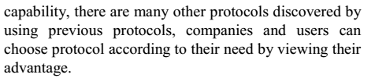
So, which one is better?
It depends on the use case.
All cp have strength and weaknesses.
What about those that do not have any weaknesses?

Slide 38
But Clearly PoS and DPoS are way better than PoW

